Slide 1
Serverless Workflow
New approach to container orchestration
Tihomir Surdilovic, Red Hat
Ricardo Zanini Fernandes, Red Hat

Slide 2
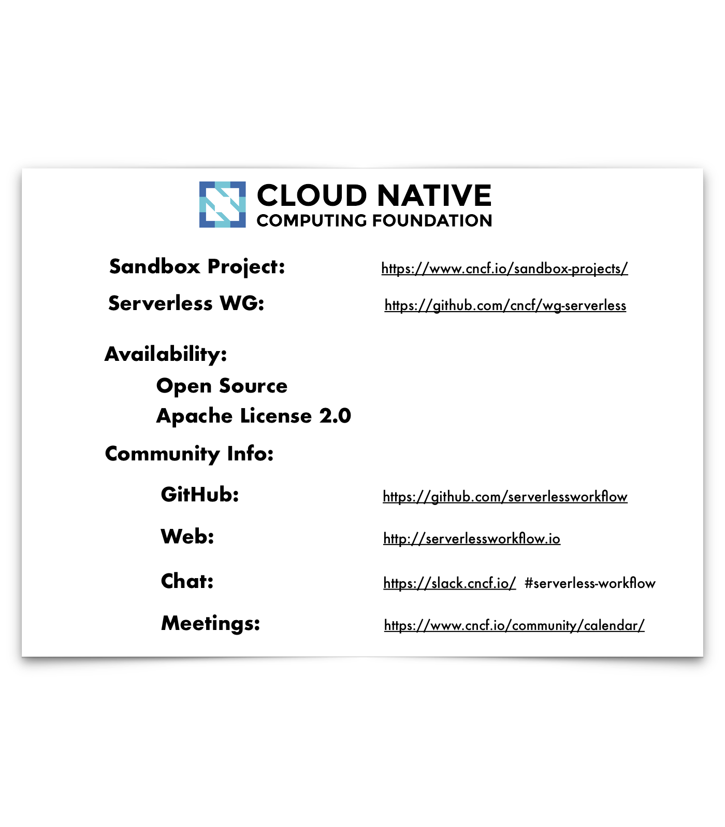

Serverless Workflow

Slide 3
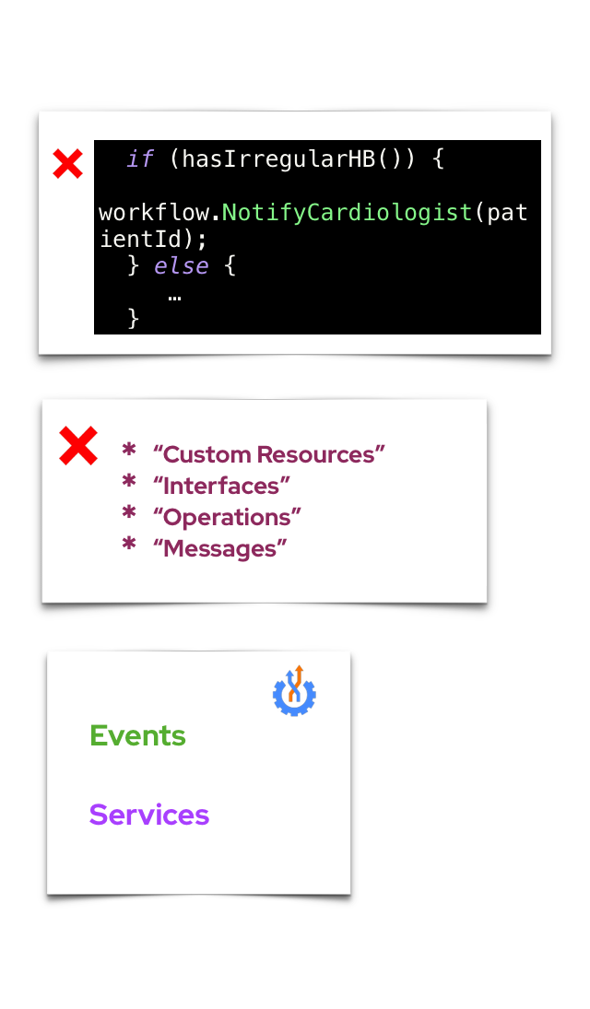
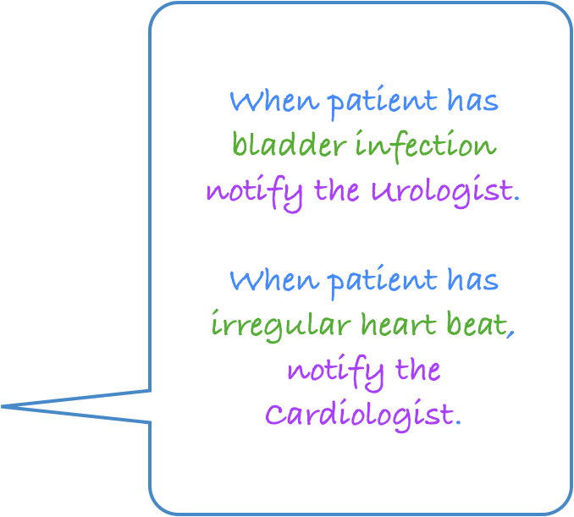


Serverless Workflow
Declarative, domain-specific workflow language
(Orchestration of event-driven, distributed services)

Slide 4
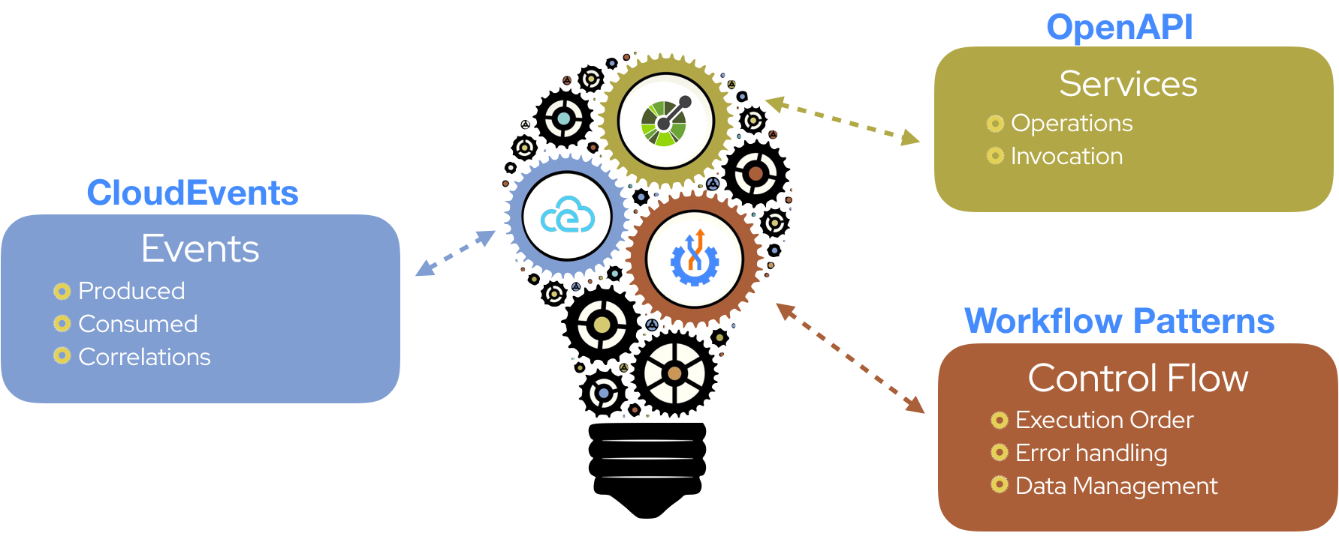
Serverless Workflow
Based on standards

Slide 5
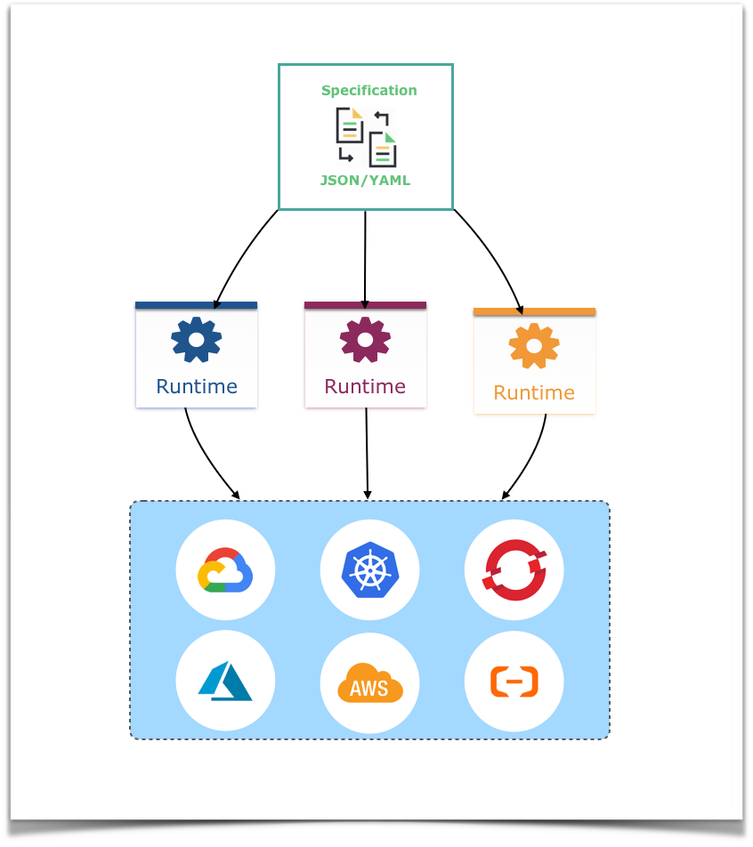
Serverless Workflow
Project Goals
Portable
Vendor-neutral

Slide 6
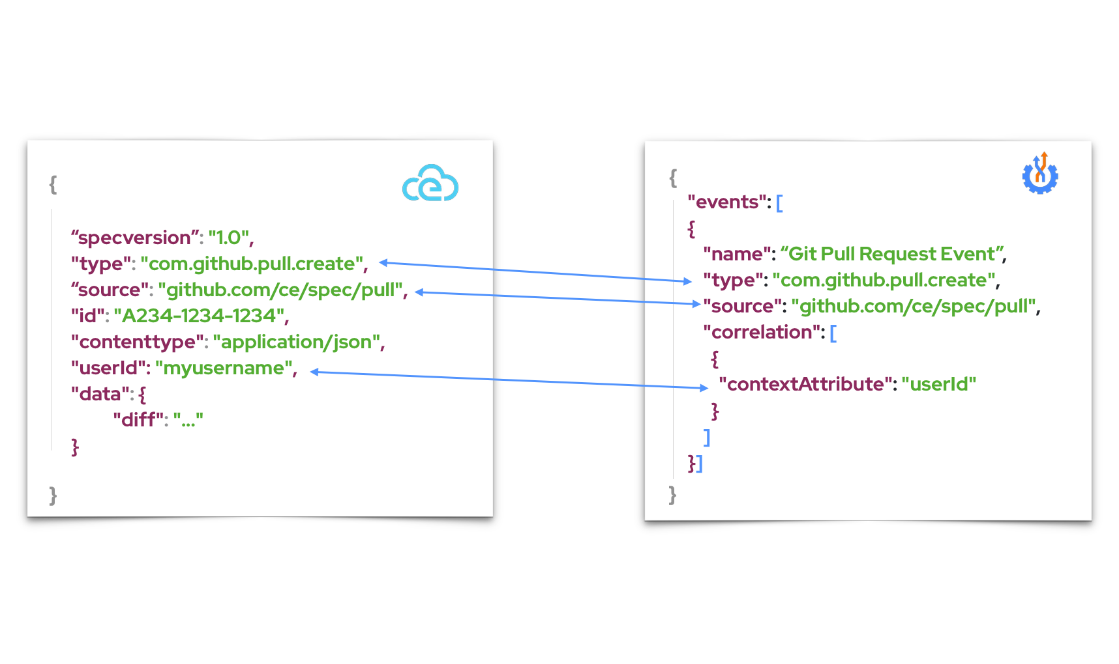
Serverless Workflow
Event Definitions
“Define events that are consumed or produced
during workflow execution.”

Slide 7
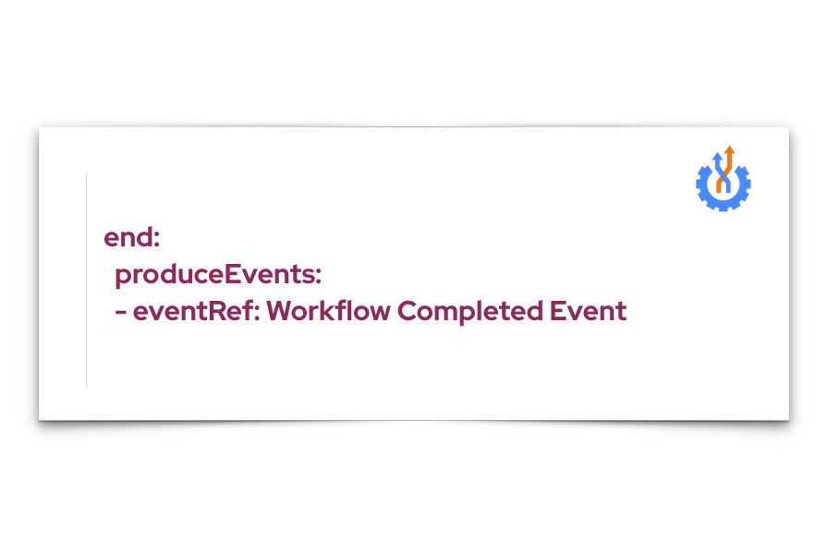
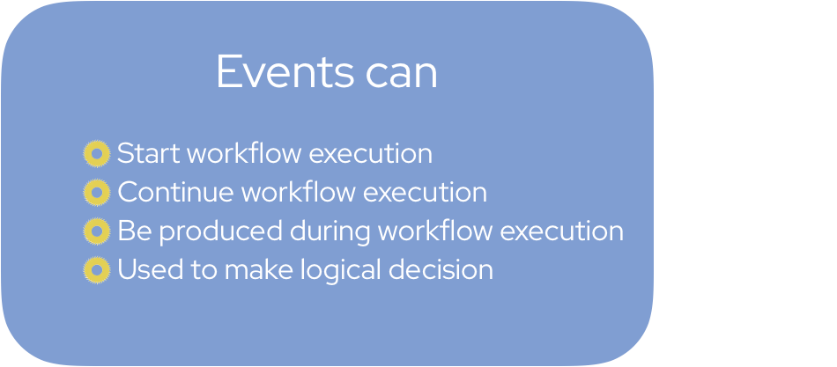
Serverless Workflow
Interactions with Events
Produce event example

Slide 8
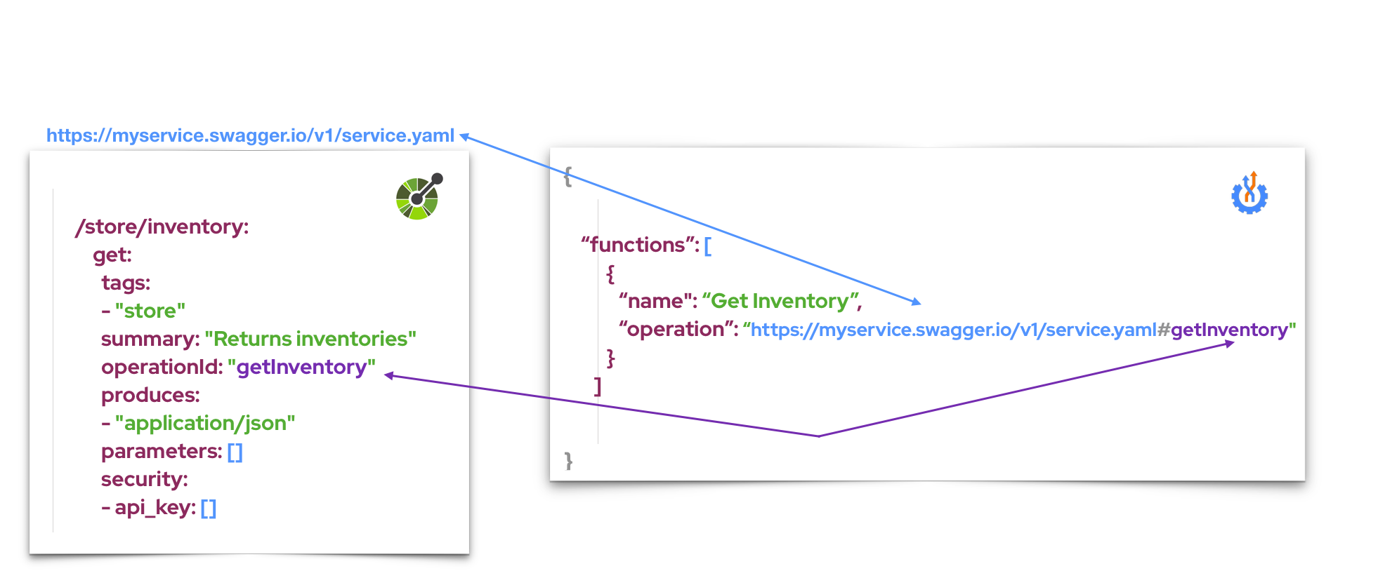
Serverless Workflow
Function Definitions
“Define service operations that need to be
invoked during workflow execution”

Slide 9
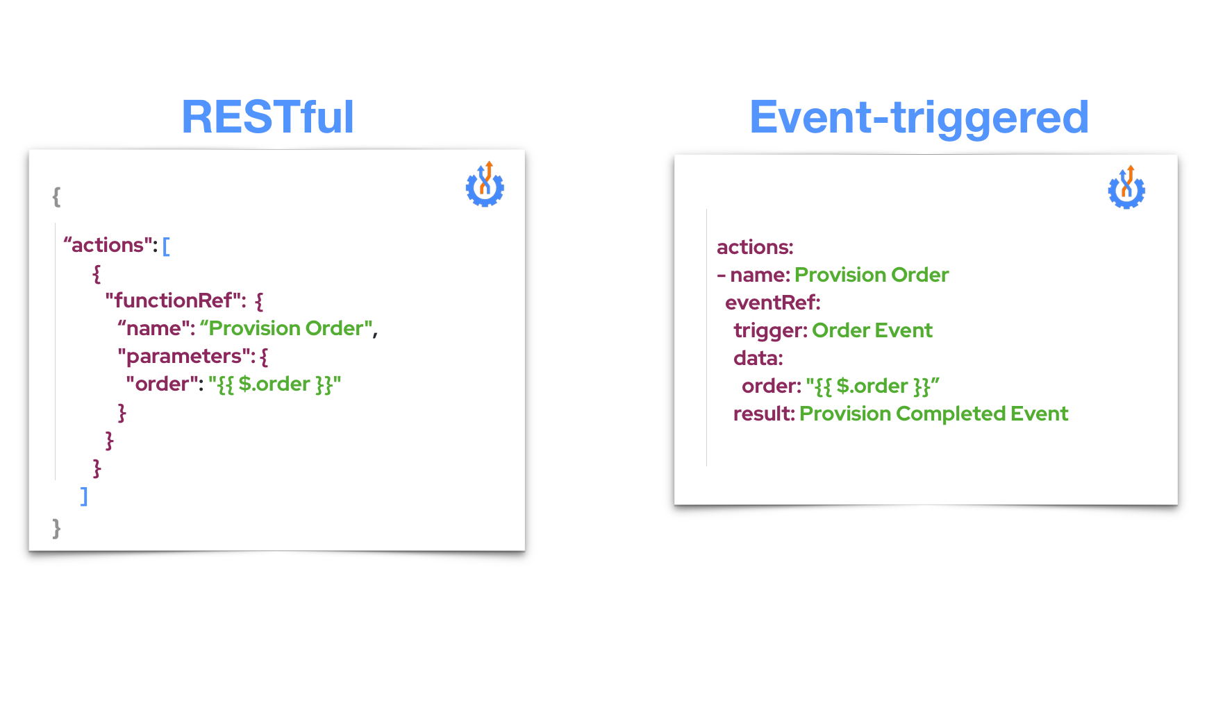
Serverless Workflow
Invoking Services

Slide 10
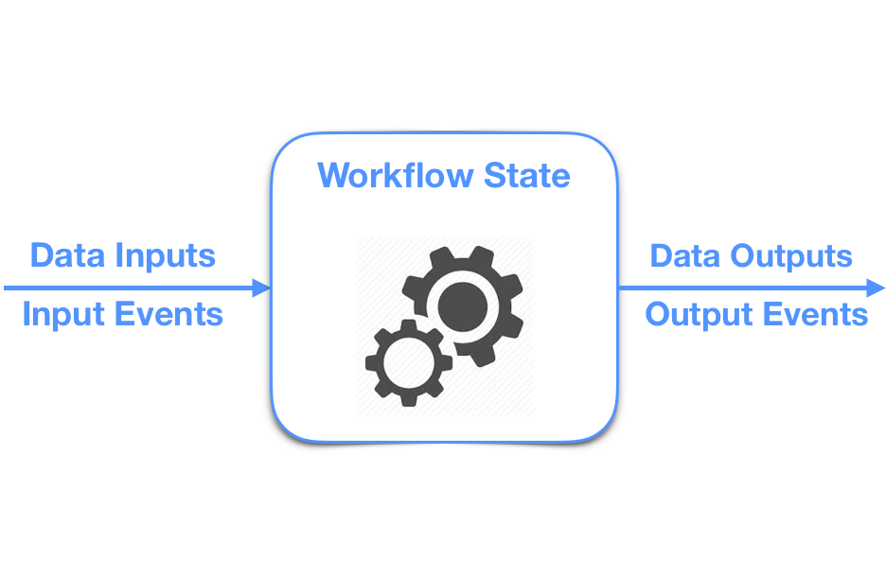
Serverless Workflow
Control Flow Logic
“Define workflow states and
the order in which they are executed”

Slide 11
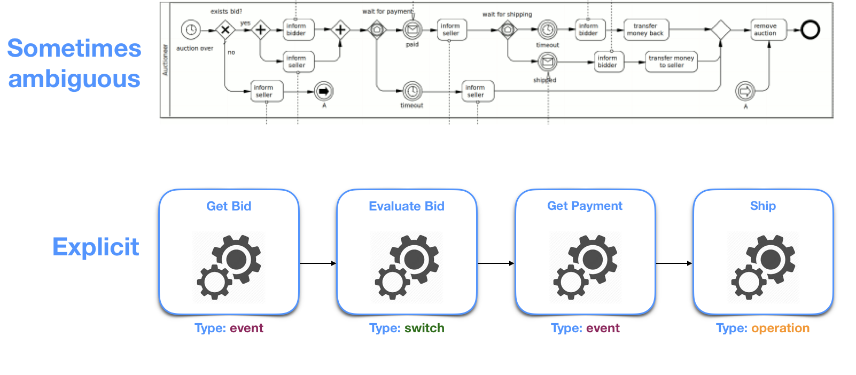
Serverless Workflow
Explicit Control Flow
“Clearly define what you are building”

Slide 12
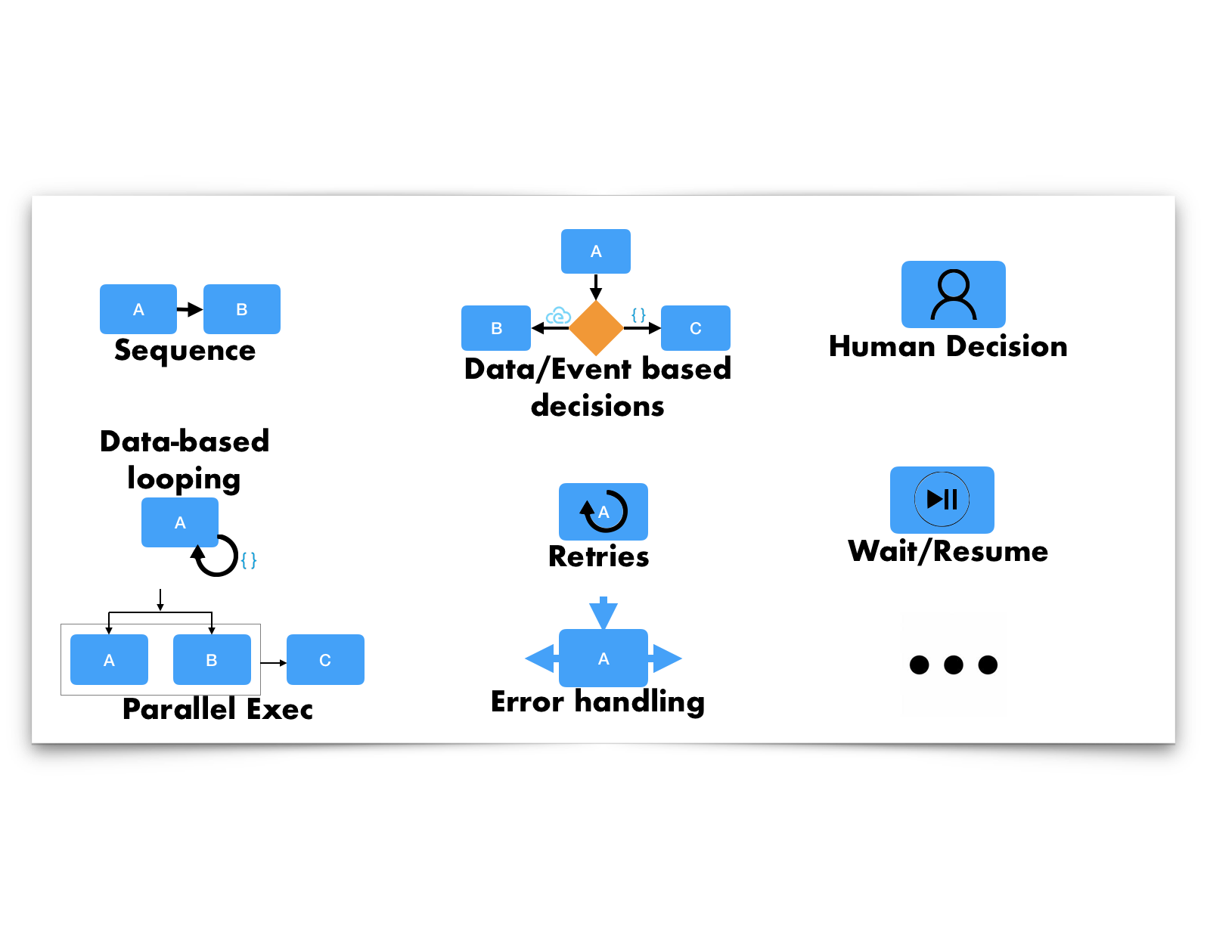
Serverless Workflow
Control Flow Patterns

Slide 13
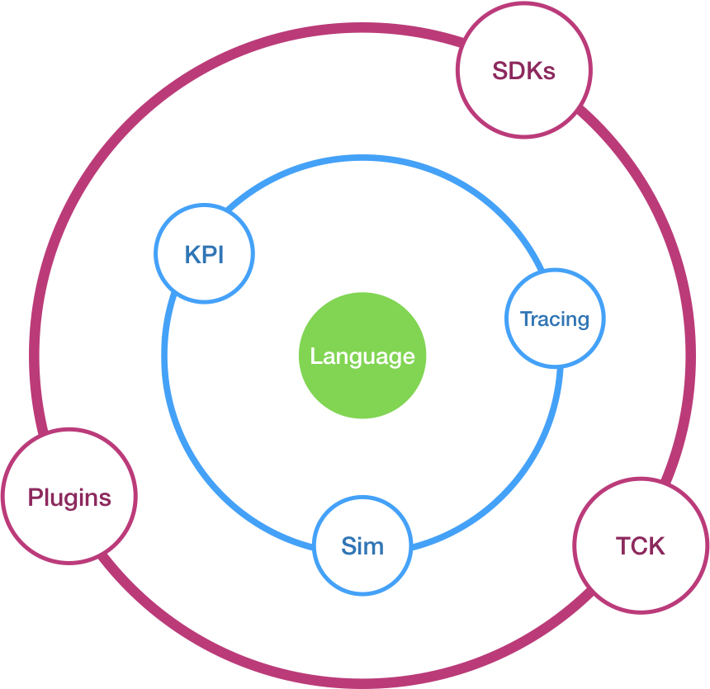
Serverless Workflow
Project Components

Slide 14
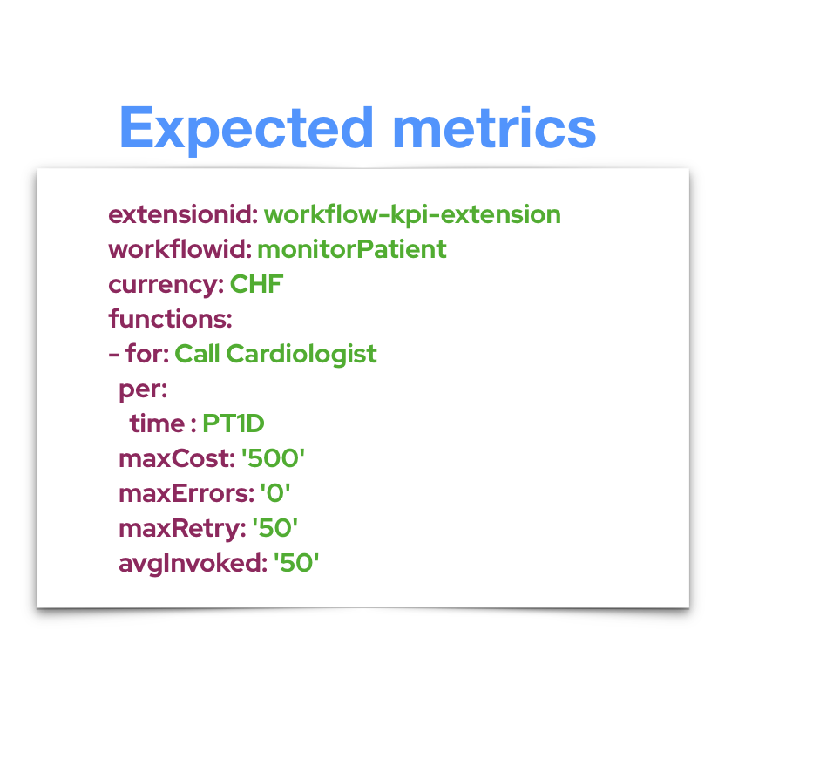
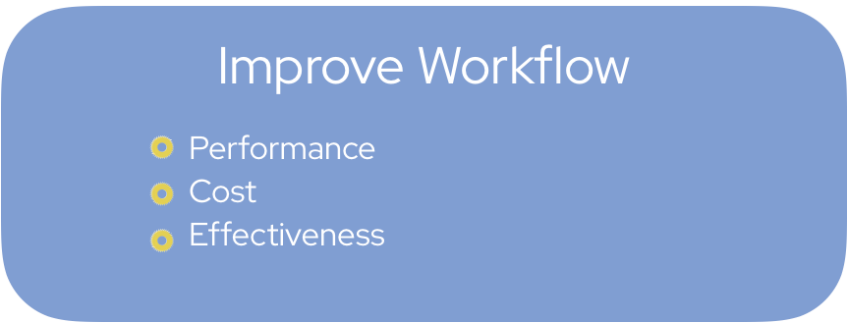
Serverless Workflow
Quick glance - Workflow KPI Extension
“Compare expected vs. actual data”

Slide 15
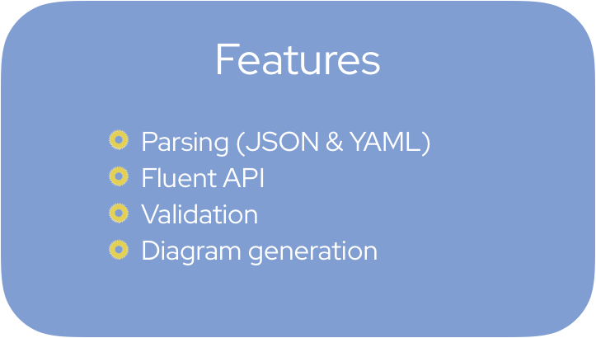
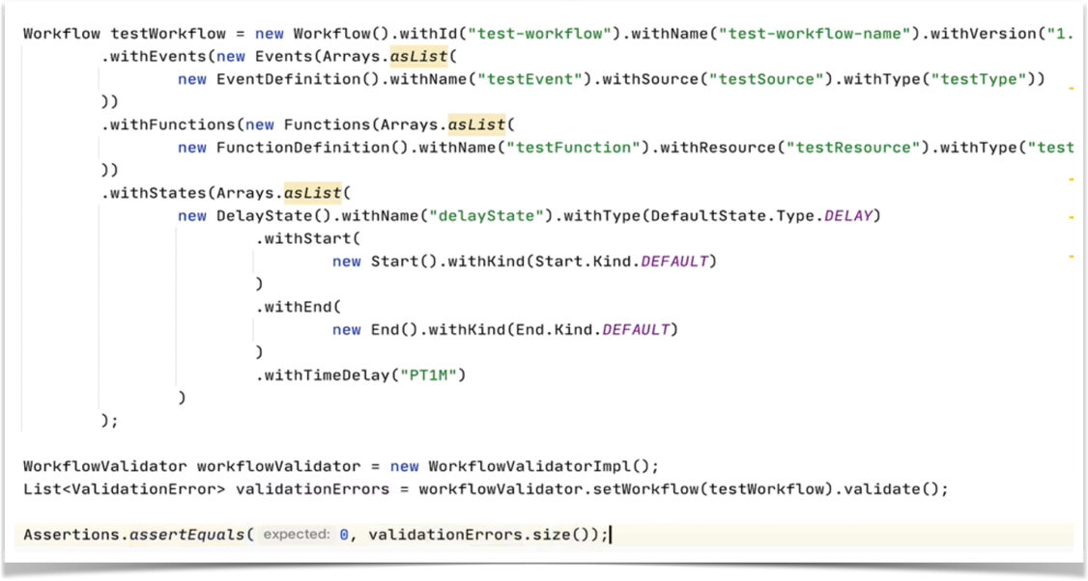
Serverless Workflow
Quick glance - JAVA SDK

Slide 16
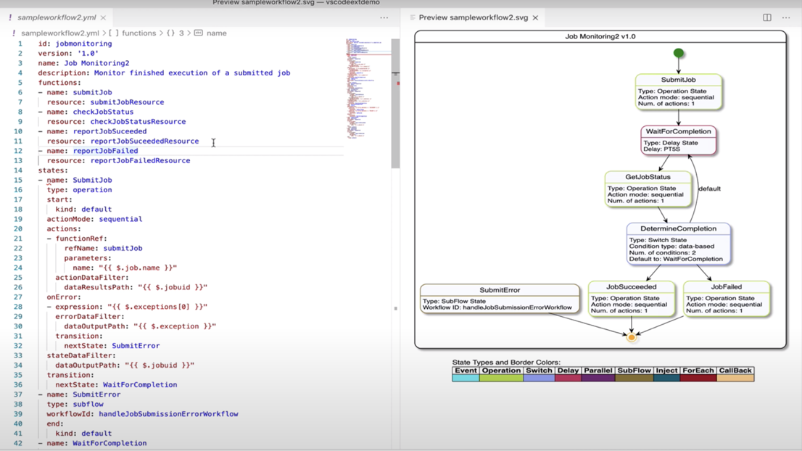
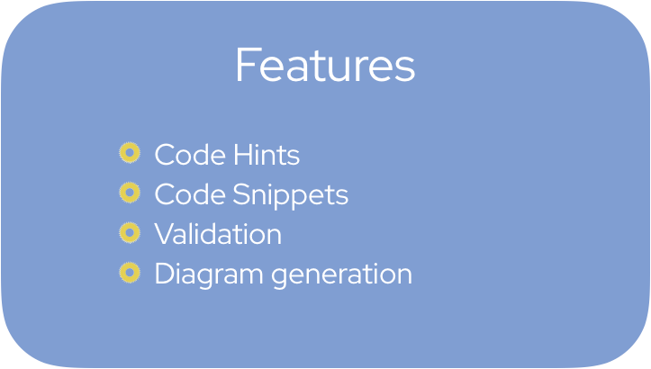
Serverless Workflow
Quick glance - VSCode Plugin

Slide 17
Demo

Slide 18
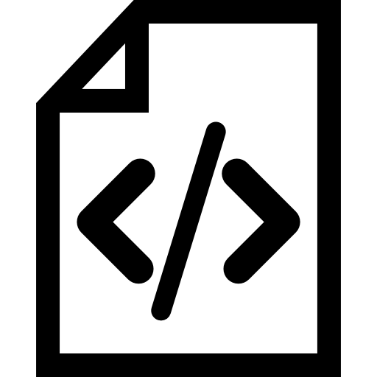


Demo - Use Case
Label
1
Open a new PR
Have my Pull Request labeled and assigned to the correct reviewer
2

Slide 19

Demo - Proposed Workflow
Apply the correct labels
A PR has been opened or changed
What has been changed?
Notify that the PR has been verified
Add the required reviewers

Slide 20

Demo - Implementation
Pull Request Verified
Pull Request Event
Broker
Notification Service
Pull Request Event
Pull Request Verified
GitHub API Functions
Workflow Runtime
Sync Calls to GitHub API to perform actions in the given PR

Slide 21




Demo - Implementation Technology
Kogito implements the Serverless Workflow Specification to orchestrate the events and make calls to underlying functions within the cluster
Knative is the serverless platform to handle CloudEvents and our functions deployments
Java functions are implemented with Quarkus as the runtime engine
Camel is the integration platform used to call third party services such as Slack API

Slide 22
Running the Demo

Slide 23
Q&A - Thank You!
More information
Serverless Workflow: https://serverlessworkflow.io
Specifications repo: https://github.com/serverlessworkflow/specification
Biweekly meetings, every second Monday at 1PM ET (see repo for dial-in info and slack coordinates)
Demo source code:
https://github.com/kiegroup/kogito-examples/tree/master/serverless-workflow-github-showcase
Need more?
Tihomir Surdilovic - @tsurdilo
Ricardo Zanini - @zaninirica

